Slide 1

Statistical Learning for dummies
Goal is to start learning about modelling with the caret package.
Go over theory first
keywordsuggest.org

Slide 2
Statistical learning
Going back to secondary school math....
What measures would you use to describe a population
Mean vs median, standard deviation, interquartile range
Statistical Learning is slightly different: what inputs lead to a certain output?

Slide 3
examples
Inputs = price, store location, season, discount levels
Output = how do these inputs influence buying behaviour?
Inference problem (understanding how inputs influence outputs is important)
Inputs = Patient's disease history, number of emergency room entries, blood sample test results
Output = chance of developing sepsis
Prediction problem (understanding how inputs influence the outputs is less important. )

Slide 4


Supervised and Unsupervised Learning
Supervised learning = labels
Unsupervised learning = no label
CAT
DOG

Slide 5
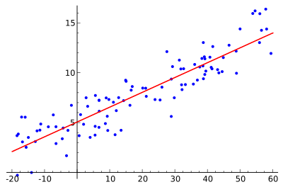
Supervised Learning – Linear Regression
Can we predict score (continuous variable) from other variables in the data?
What inputs would be relevant?
What does linear regression assume? (hint: what does linear mean)

Slide 6
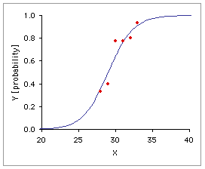
Supervised Learning – Logistic Regression
We can ask the question in a different way
Instead of scores, look at passes and fails (binary outcome)

Slide 7
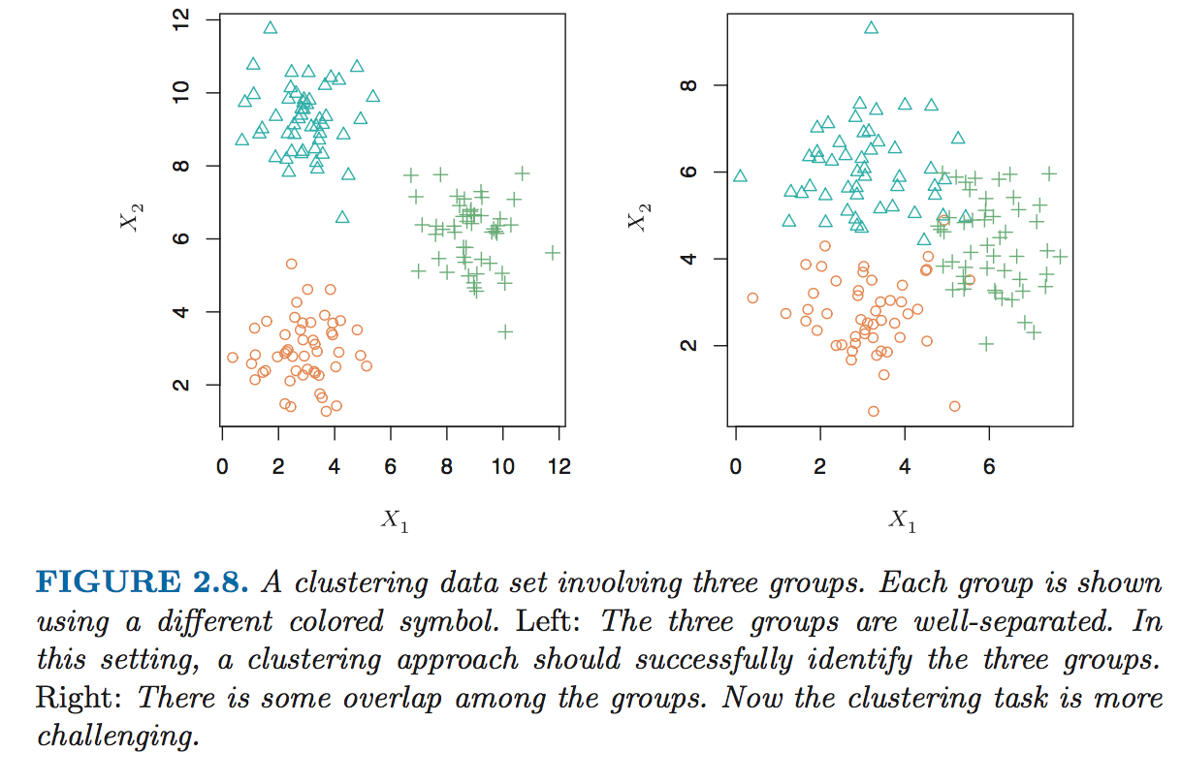
Unsupervised Learning – K-means clustering
Do students fall into groups we may not think of?
Source: Introduction to Statistical Learning 4th

Slide 8
Review
Explain to your partner:
1. What is the difference between supervised and unsupervised learning?
2. Give an example of an inference problem and a prediction problem

Slide 9
1. train model
Basic Steps:
Split data into training and test set (70:30 or 80:20)
Run model (linear regression/logistic regression) on training data
Evaluate model by running model on test data
More complicated:
Split data into training and test set
Run model many times on different subsamples of training data (called resampling. Common method include cross validation and bootstrap)
Only finally, finally, running model on test data.

Slide 10
2. Measure Model Accuracy
Measure model performance by measuring how well predictions match observed test data
Mean Square Error for linear regression
Confusion matrix for logistic regression
For unsupervised problems, this is more difficult (huge amount of literature)

Slide 11
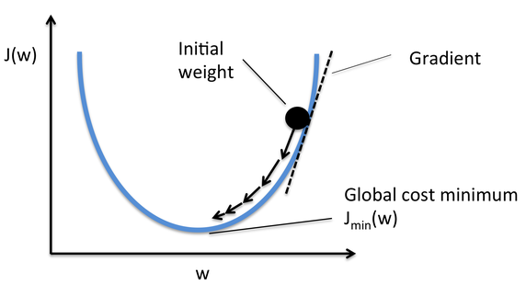
3. Optimisation
Looking for the best combination of parameters that minimises objective function eg. MSE
1. Manual tweaking (good for building understanding)
2. Use algorithms like Stochastic Gradient Descent (minimise loss function)

Slide 12
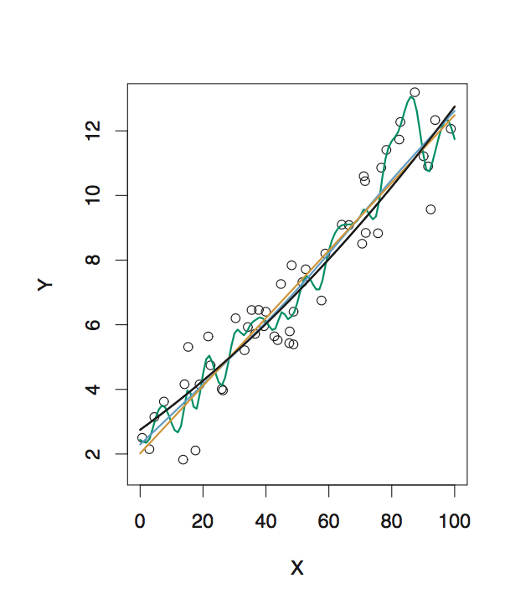
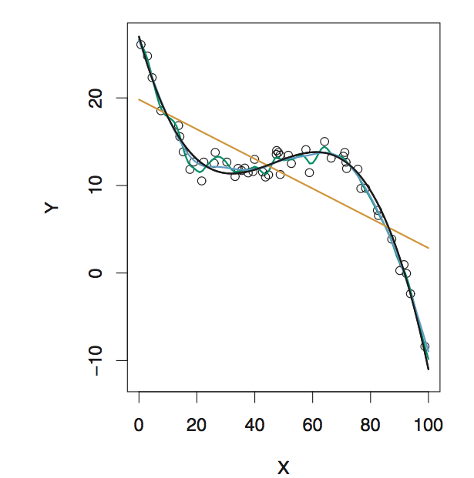
4. Are we Overfitting and underfitting?
Overfitting = model fits training data very well, but does not generalise to new data
Underfitting = model does not fit data well enough, therefore does not capture trends.
Straight line might underfit
Curved line might overfit

Slide 13
Review
Get your partner to check your understanding:
1. Without looking at the slides, outline the four steps we touched on earlier

Slide 14
References
Introduction to Statistical Learning by Gareth James et al. – in-depth yet still accessible. Good for verifying your knowledge while building models
Quora for layman explanations

